Slide 1
SSW-810: Software Engineering Tools and Techniques
Advanced Function Parameters
Python Modules
Working with files
Working with the Web
Prof. Jim Rowland
Software Engineering
School of Systems and Enterprises

Slide 2
Acknowledgements
This lecture includes material from:
“How to Think Like a Computer Scientist: Learning with Python 3 (RLE)”, Peter Wentworth, Jeffrey Elkner, Allen B. Downey, and Chris Meyers,
http://openbookproject.net/thinkcs/python/english3e/
“Introducing Python”, Bill Lubanovic, ISBN-13: 978-1449359362
http://proquest.safaribooksonline.com/book/programming/python/9781449361167
https://docs.python.org/3/library/stdtypes.html
https://mkaz.tech/python-string-format.html

Slide 3

Today’s topics
Advanced function parameters
Python modules and packages
Working with files
Working from the Web

Slide 4
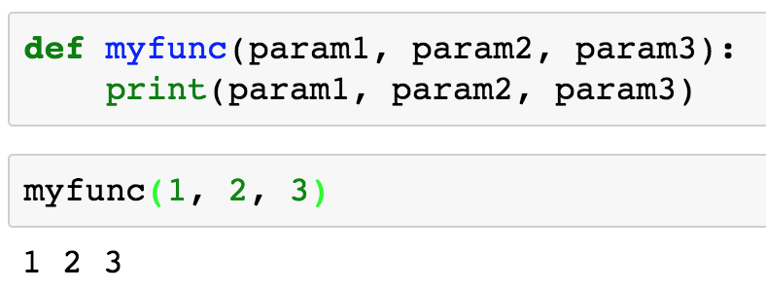
Function parameters and arguments
A function or method defines parameters
Arguments are the values that are passed to the function or method
Parameters are assigned to arguments by position
Parameters are used in the function/method definition
Arguments are passed to the function and are assigned to the parameters by position (tuple unpacking)

Slide 5
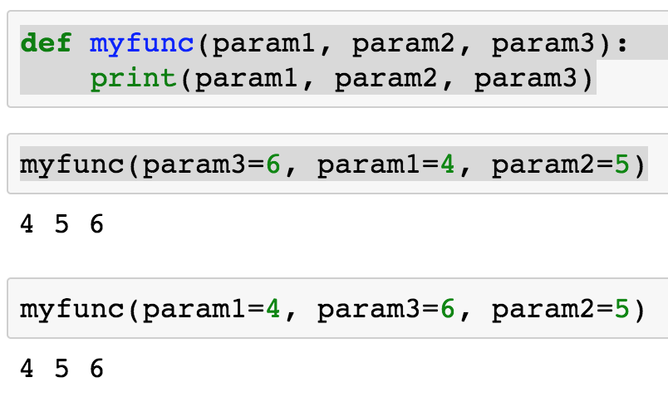
Function parameters by name
Arguments may also be passed by name
Arguments may be specified in any order when passing by name (well, almost…)

Slide 6
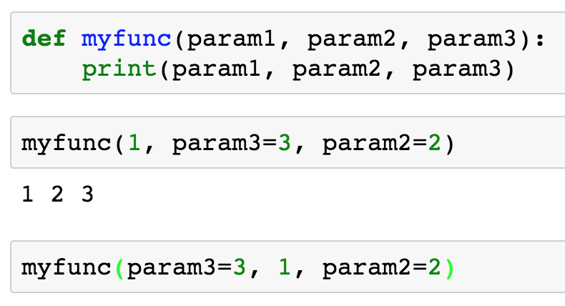
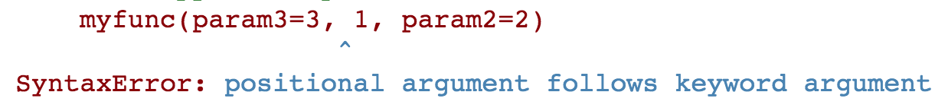
Mix positional and named arguments
All positional arguments must be specified before any named arguments
Mix positional and named arguments
All positional arguments must precede name arguments, i.e. named parameters must be specified last

Slide 7
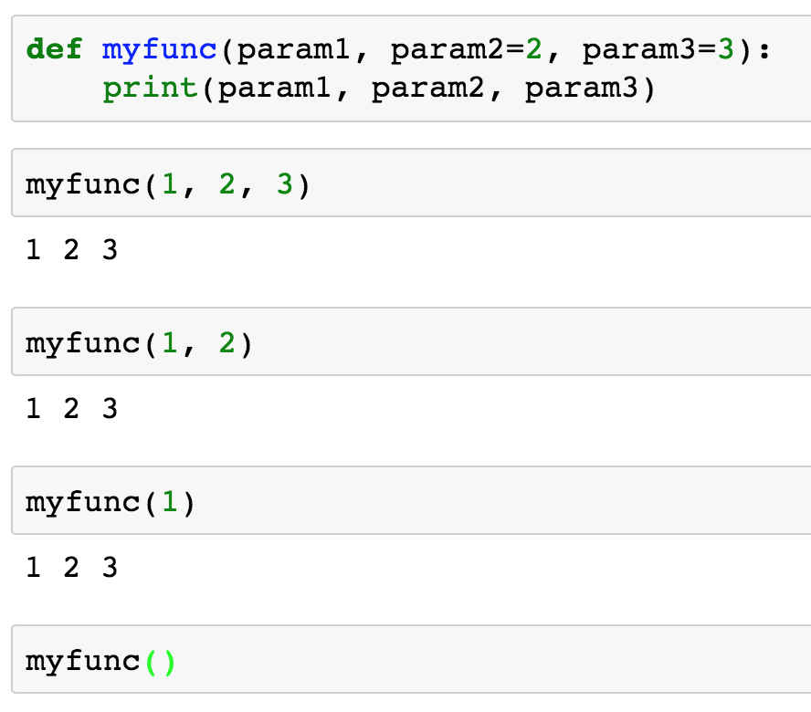
Optional parameters with default values
Functions/methods may define optional parameters that assume default values if corresponding arguments are not passed by the function call
param1 is required
param2 defaults to 2 if not specified
param3 defaults to 3 if not specified
Param1 is required

Slide 8
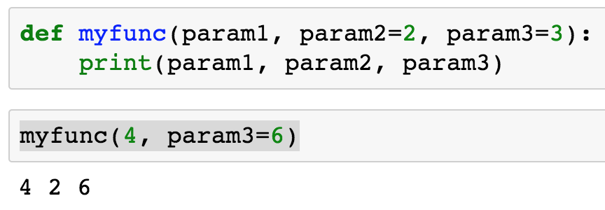
Mixing optional and named parameters
Function calls may mix positional, named, and optional arguments
param1 == 4
param2 defaults to 2
param3 passed by name

Slide 9
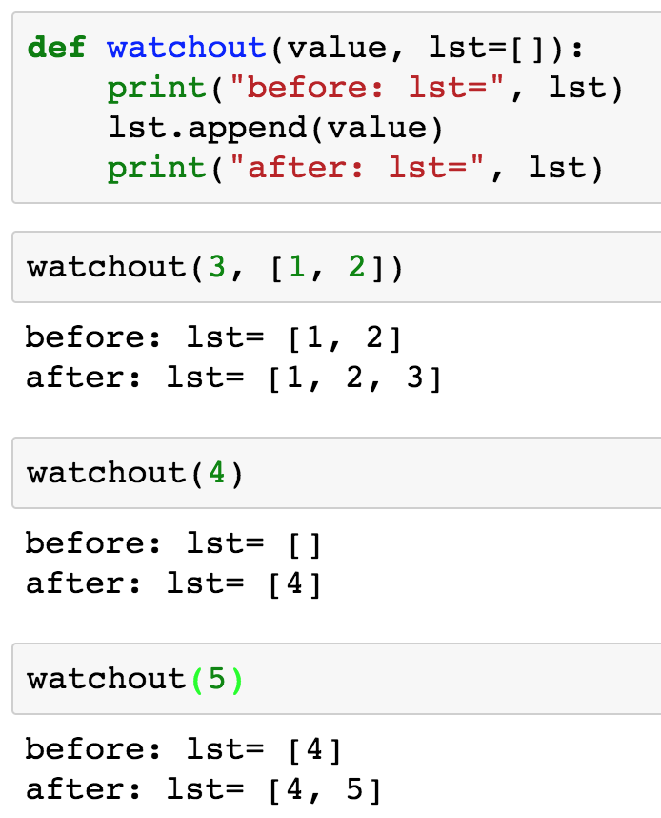

BEWARE!!!
Mutable default parameters may have unexpected surprises
Python defines the default value lst when the function is defined
Each subsequent call using the default value mutates the value
So far, so good
That’s right… What’s the problem?
WAIT!!! That should be [5]

Slide 10
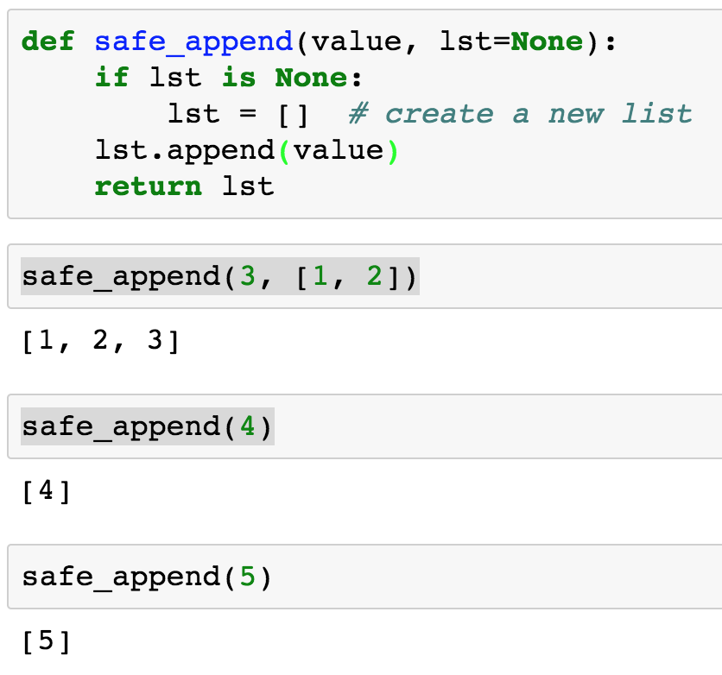

Safe alternative
If you want a new list each time, then allocate a new list each time the default argument (None) is passed.
Source: http://docs.python-guide.org/en/latest/writing/gotchas/
That’s better!

Slide 11
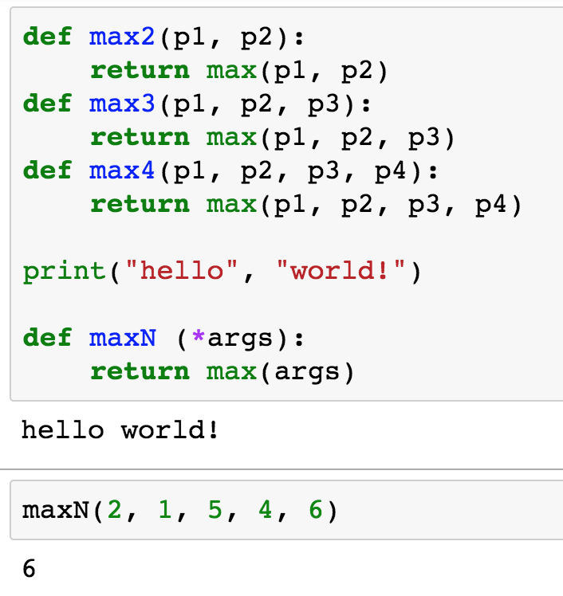

Variable number of parameters
We sometimes want to accept a variable number of parameters
How many versions do we need?
Print accepts a variable number of arguments. Can we do that?
Accept an arbitrary number of arguments and assign them to a tuple with name ‘args’

Slide 12
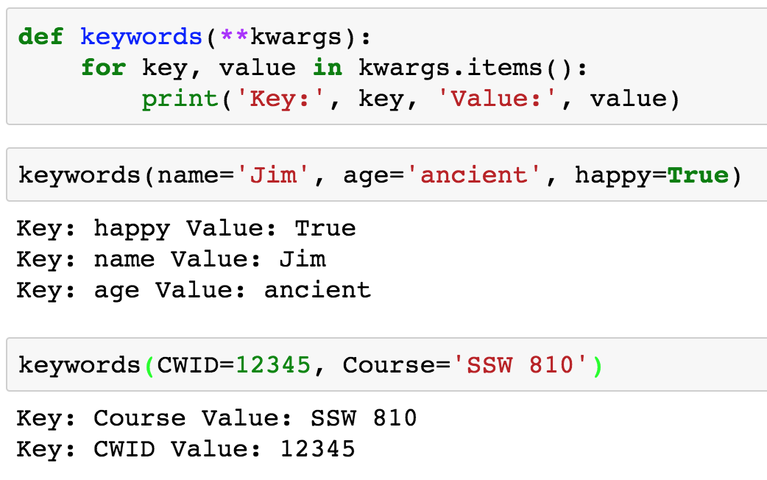
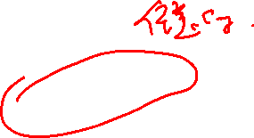
Keyword arguments
Python’s **kwargs allows passing arbitrary keywords and values to a function
Specify key and value in function call
The order of the parameters is not defined but you can access by key

Slide 13
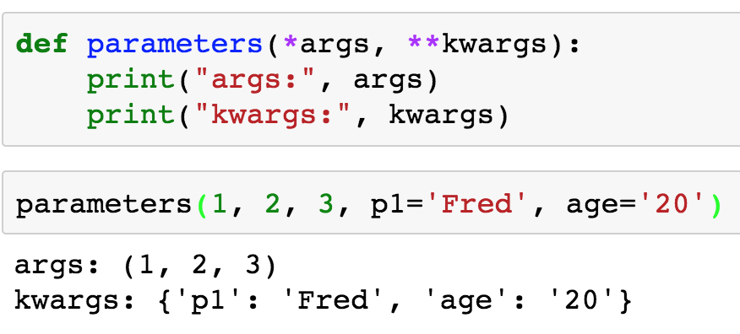
Passing any type of arguments
To capture all possible arguments to a function
args is stored as a tuple
kwargs is stored as a dict

Slide 14


Slide 15
Python modules
Python source code files may be used by other programs
Python includes many standard packages
You can make your own packages
PyPI (Python Package Index) offers 140,000+ packages
https://pypi.python.org/pypi
Your program may be split across multiple files
Use import to access shared resources

Slide 16
Installing Python Packages
Python comes with many packages preinstalled
You may need to install a few packages from time to time
See https://packaging.python.org/tutorials/installing-packages/
$ pip install package_name
$ pip install prettytable

Slide 17
3 Ways to import Python modules
import module_name [as alias]
from module_name import object_{1..n}
from module_name import *
This option blindly loads everything from the module into your namespace which may cause conflicts
Don’t do this!!!

Slide 18
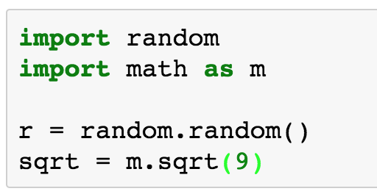
Python modules
import module_name [as alias]
All of the objects from module_name are available to your program, e.g. functions, global variables, etc.
Use dot notation to access objects within a module
Make the objects in the “random” module available to your program
Call the random() function defined within the “random” module
Call the sqrt() function defined within the “math” module

Slide 19
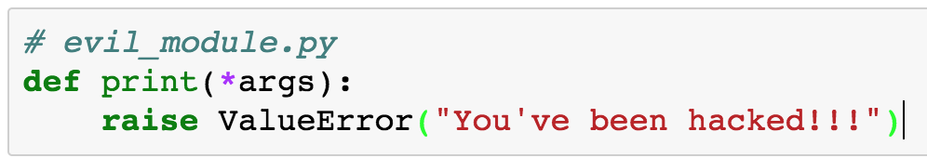
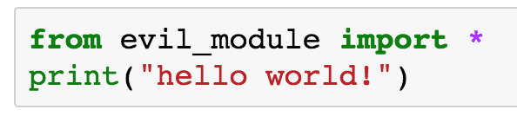
Python modules
from module_name import *
Imports everything from module_name into your module BUT you can’t control what is or is not included
Dot notation is not needed to access objects within a module
Beware that objects can be overwritten
Don’t EVER use this form!!!

Slide 20
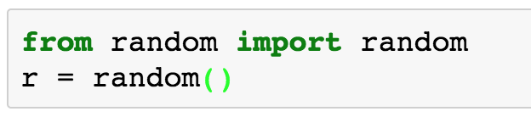
Python modules
from module_name import objects
makes specified objects from module_name available to your program, e.g. functions, global variables, etc.
Dot notation is not needed to access objects within a module
Beware that objects can be overwritten
random.random() is available without dot notation. No other objects from random have been imported, only random()

Slide 21
Namespaces: Which X is which?
Each module is associated with a single file
Each module has a namespace and all of the objects in that module are in that namespace

Slide 22
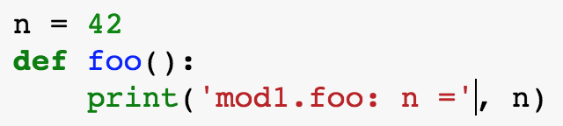
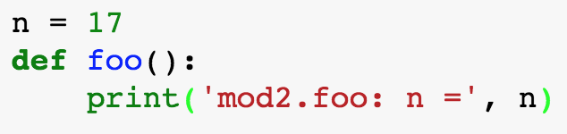
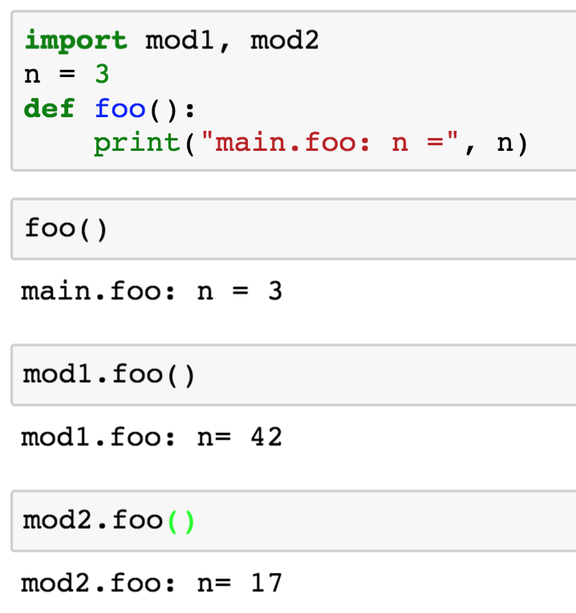
Namespaces: Which x is which?
Module: mod1.py
Module: mod2.py

Slide 23
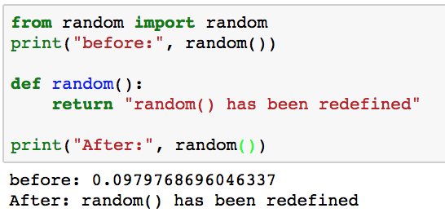

What could go possibly go wrong?

Slide 24
Breaking projects into files
Larger programs typically include multiple files
Projects are frequently written by teams
Different developers write different components
Integrate the files together into a solution
You can make your own packages
Program
Package
Module
Package
Class
Function
Methods
Class Attributes
Module
Class
Methods
Class Attributes
Function
Module

Slide 25
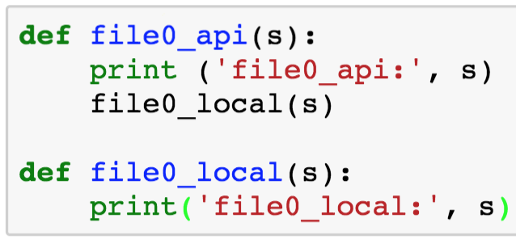
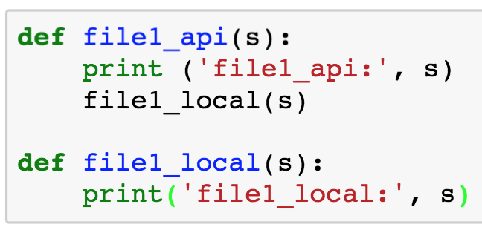
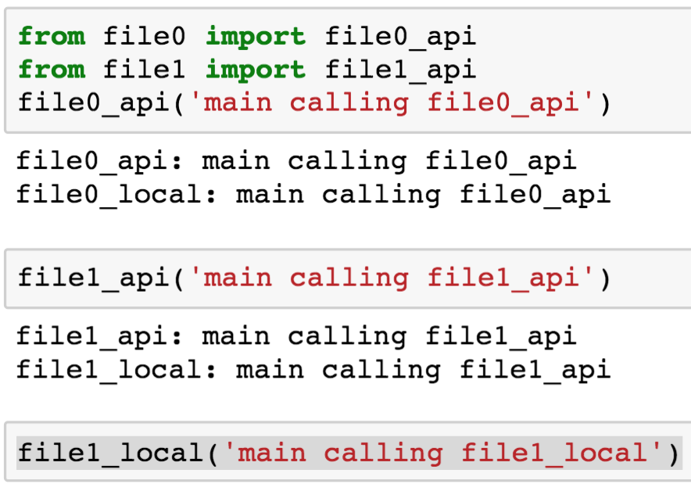
Projects with multiple files
modules_file0.py
modules_file1.py
Imported objects are accessible
Only imported objects are accessible

Slide 26

Useful Python modules
We’ll explore a few useful packages
Python includes many standard packages
sys, random, math, time, datetime, os, …
You can create and contribute your own packages

Slide 27
Sys module
Operating system functionality
import sys
https://docs.python.org/3/library/sys.html
Object | Semantics
sys.exit() | Terminate the process gracefully
sys.modules | See the modules that have been loaded
sys.path | Search path for modules
sys.stdin, sys.stdout, sys.stderr | Control input, output, and error files
sys.argv | Command line arguments
sys.getopt | Parse command line arguments
Many others

Slide 28
Command line arguments: sys.argv
$ cat 06-argv.py
import sys
print('Found {} arguments'.format(len(sys.argv)))
print(’argv: {}'.format(sys.argv))
$ python 06-argv.py hello world
Found 3 arguments
argv: ['06-argv.py', 'hello', 'world']
getopt, argparse, … modules help to parse command line arguments

Slide 29
Random number module
Pseudo-random numbers
import random
https://docs.python.org/3/library/random.html
Object | Semantics
random.seed(a=None) | Initialize the random number generator. You can use this to reproduce the same random number sequence.
random.randint(a,b) | Return a random integer, n, where a <= n <= b
random.random() | Return a random float f, where 0 <= f <= 1.0
random.choice(sequence) | Return an random element from sequence
Many others

Slide 30
Math module
Math functions
import math
https://docs.python.org/3/library/math.html
Object | Semantics
math.ceil(n) | Return ceiling(n)
math.factorial(n) | n!
math.floor(n) | Largest integer <= n
math.trunc(n) | Truncate real values to integers
math.exp(n) | Return e**n
math.pow(x,y) | Return x**y
math,sin(x), math.cos(x), math.tan(x), …

Slide 31
Time module
Use time module to measure time spent running Python code
Helpful for performance analysis of algorithms
Task: compare the performance of two implementations of factorial
math.factorial(n)
recursive implementation of factorial

Slide 32
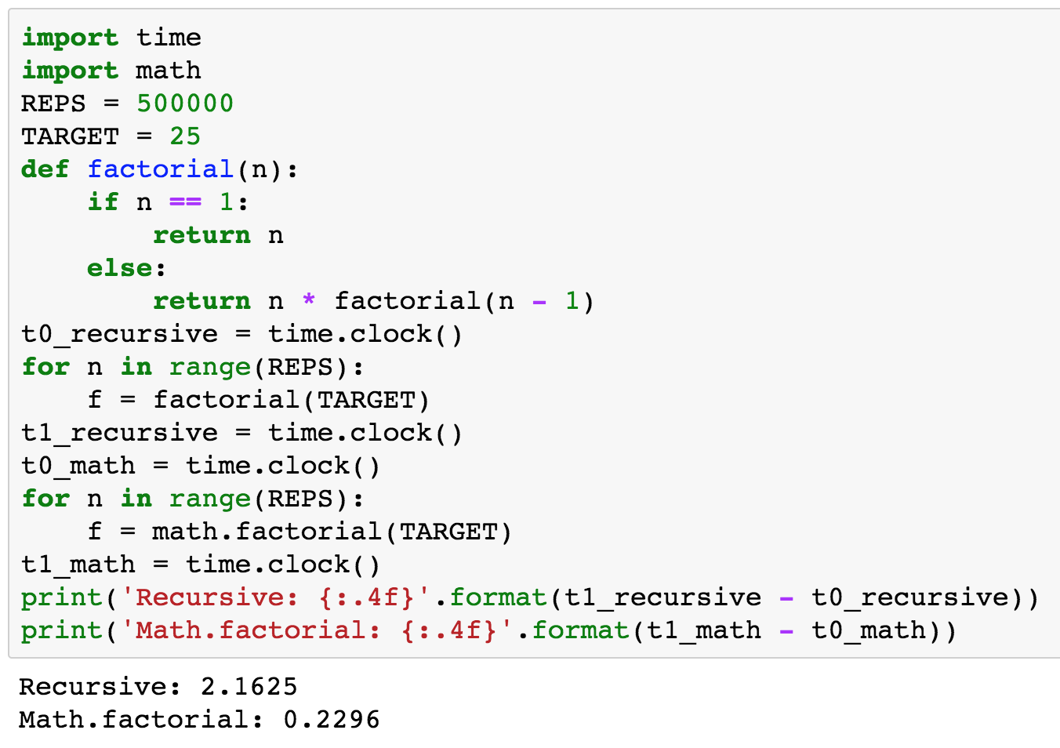
Performance comparison
Timing Results
Recursive: 2.2077
math.factorial: 0.2586
Note time at start of test
Note time at end of test

Slide 33

datetime module
Date arithmetic is a common task
Harder than you might think:
3 days from now
4 months ago
Last 90 days
date2 – date1
…
https://docs.python.org/3/library/datetime.html

Slide 34
Reading and writing dates
Dates take many forms
8/29/16 Aug 29, 2016 29/8/2016
datetime.datetime.strptime() parses strings as dates
datetime.datetime.strftime() formats dates
https://docs.python.org/3/library/datetime.html#strftime-strptime-behavior has a complete list of many alternatives

Slide 35
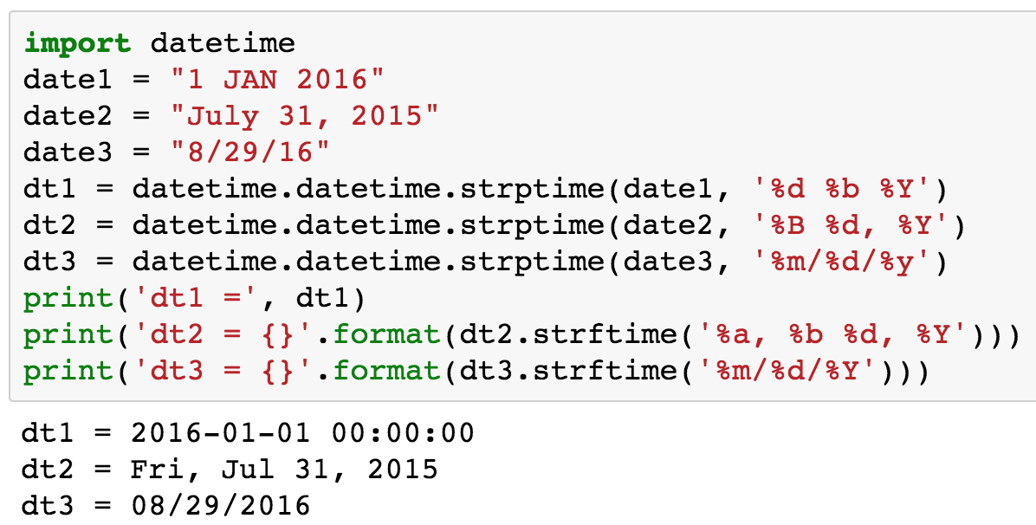
Reading and writing dates

Slide 36
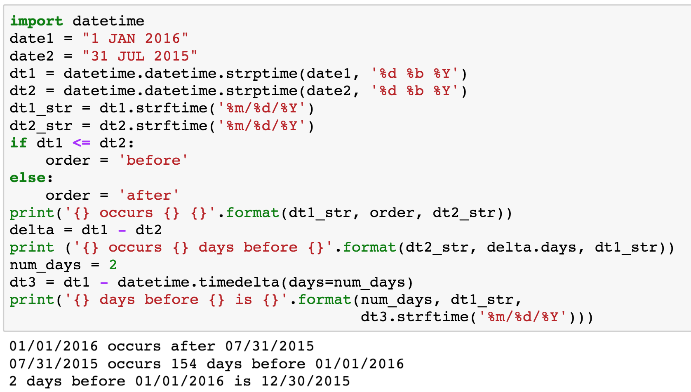
Date arithmetic
Output:
01/01/2016 occurs after 07/31/2015
07/31/2015 occurs 154 days before 01/01/2016
2 days before 01/01/2016 is 12/30/2015

Slide 37
os module
Access to the underlying operating system
import os
These are helpful when reading/writing files
https://docs.python.org/3/library/os.html
Object | Semantics
os.chdir(path) | Set current working directory to path
os.getcwd() | Get current working directory
os.listdir(path=‘.’) | Return a list of files in the specified directory
os.path.join(dir, file_name) | Create a path from a directory and file name
os.path.basename(path) | Return the file name at the base of a path

Slide 38
Working directories
Python runs in the Current Working Directory (CWD)
Typically the directory holding the .py file being run
Must specify full path or change CWD to access a file in a different directory
/
Documents
810
Downloads
data.txt
pgrm1.py
Users
jrr
Current Working Directory (CWD)

Slide 39
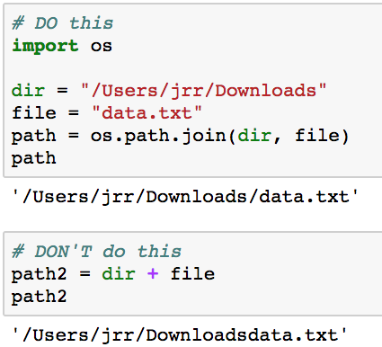

os.path.join(dir, file)
os.path.join(dir, file) does the right thing across operating systems and if path ends with or without trailing ‘/’

Slide 40
PrettyTable module
PrettyTable provides a convenient to format tables
Say we want to print the data in a table
CWID | FirstName | LastName
10001001 | Nanda | Koka
10001002 | Sujit | Behara
10001003 | Fei | Hou

Slide 41
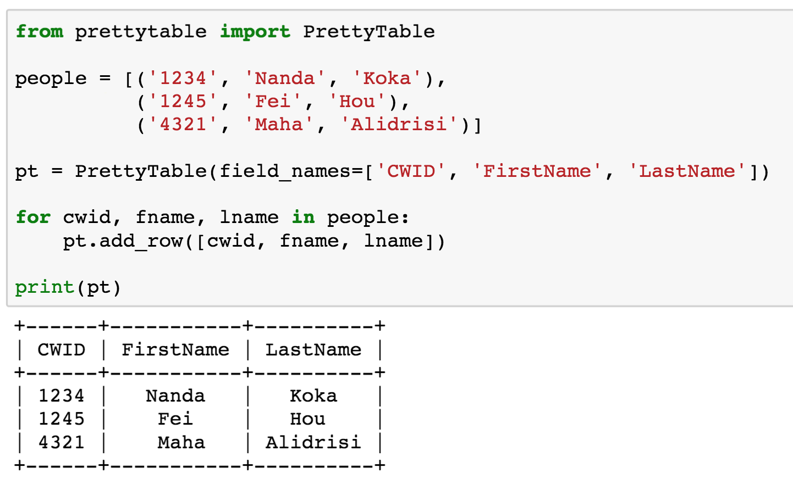

PrettyTable example

Slide 42
Modules summary
There are many useful Python modules
Check PyPi for existing modules before writing your own
https://pypi.python.org/pypi

Slide 44
Working with files
Steps for reading from a file:
Get file name
Open the file
Read the file
Line by line
All at once into a list of lines
All at once into a buffer
Close the file

Slide 45
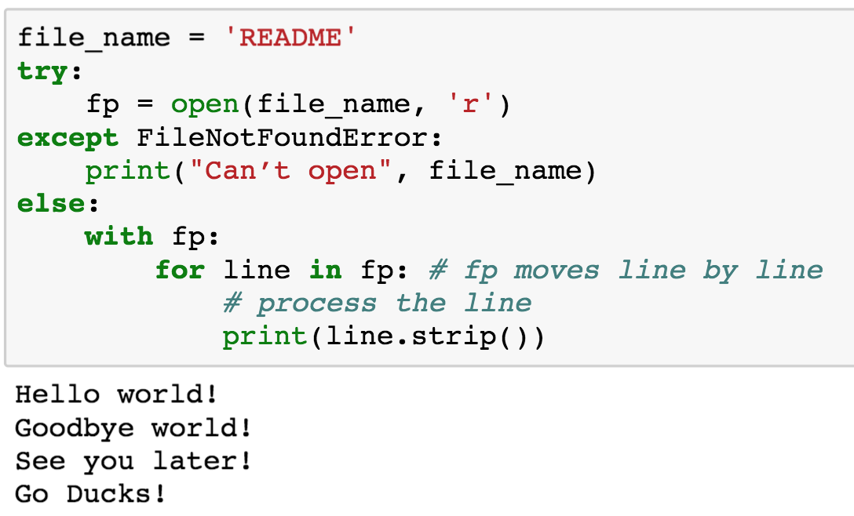
Reading a text file line by line

Slide 46
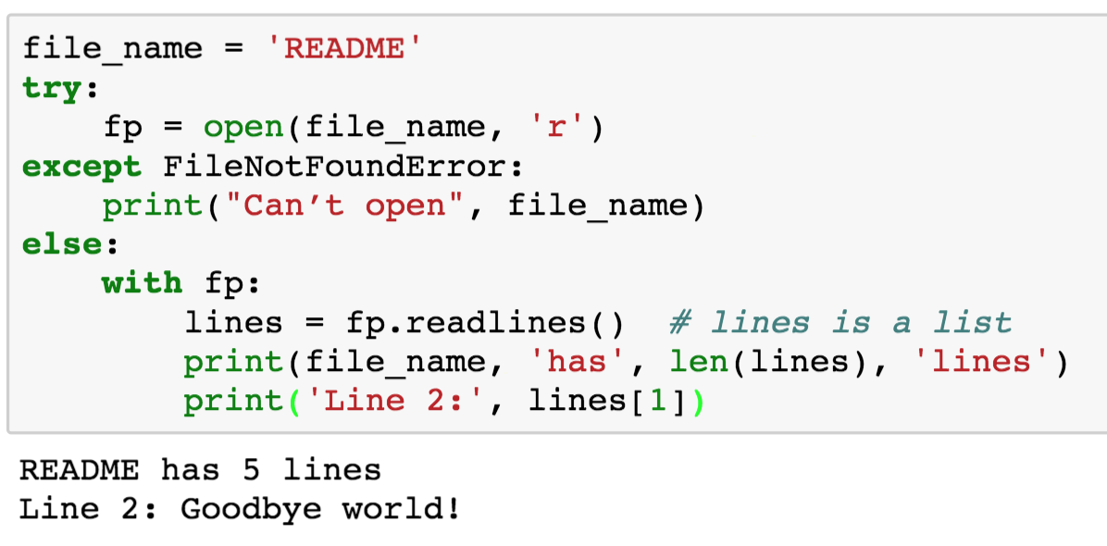
Reading a text file into a list of lines

Slide 47
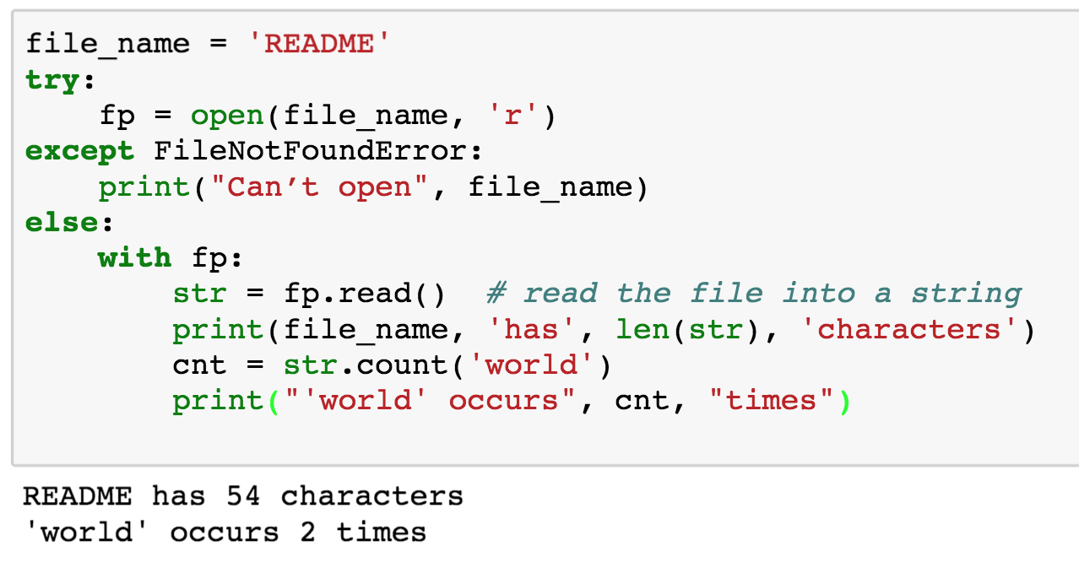
Reading a text file into a buffer

Slide 48
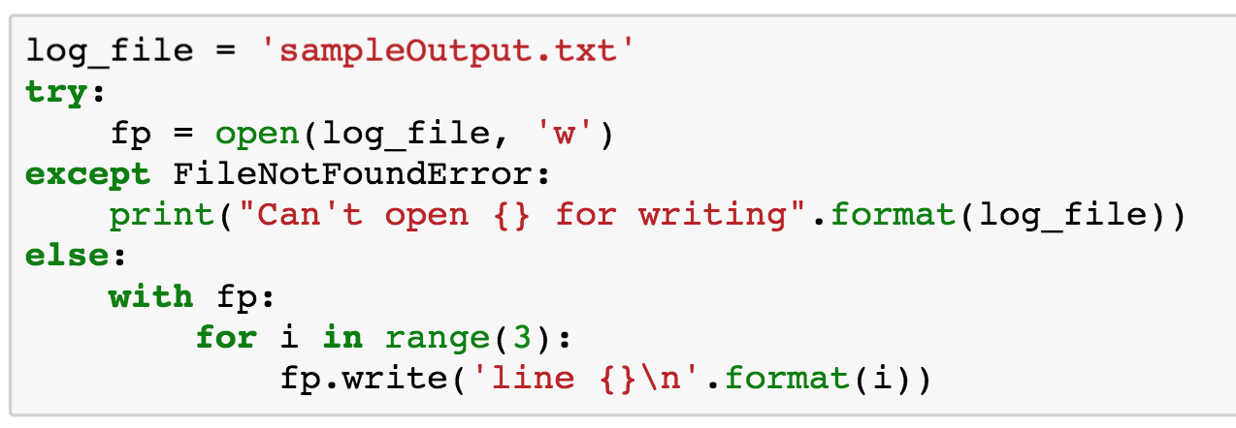
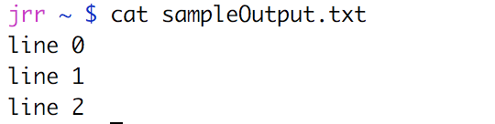
Writing to a text file
’w’ creates a new file if the file doesn’t exist or overwrites the file if it does exist
’a’ creates a new file if the file doesn’t exist or appends to the file if it does exist
Include ‘\n’ unless you want everything on one line

Slide 49
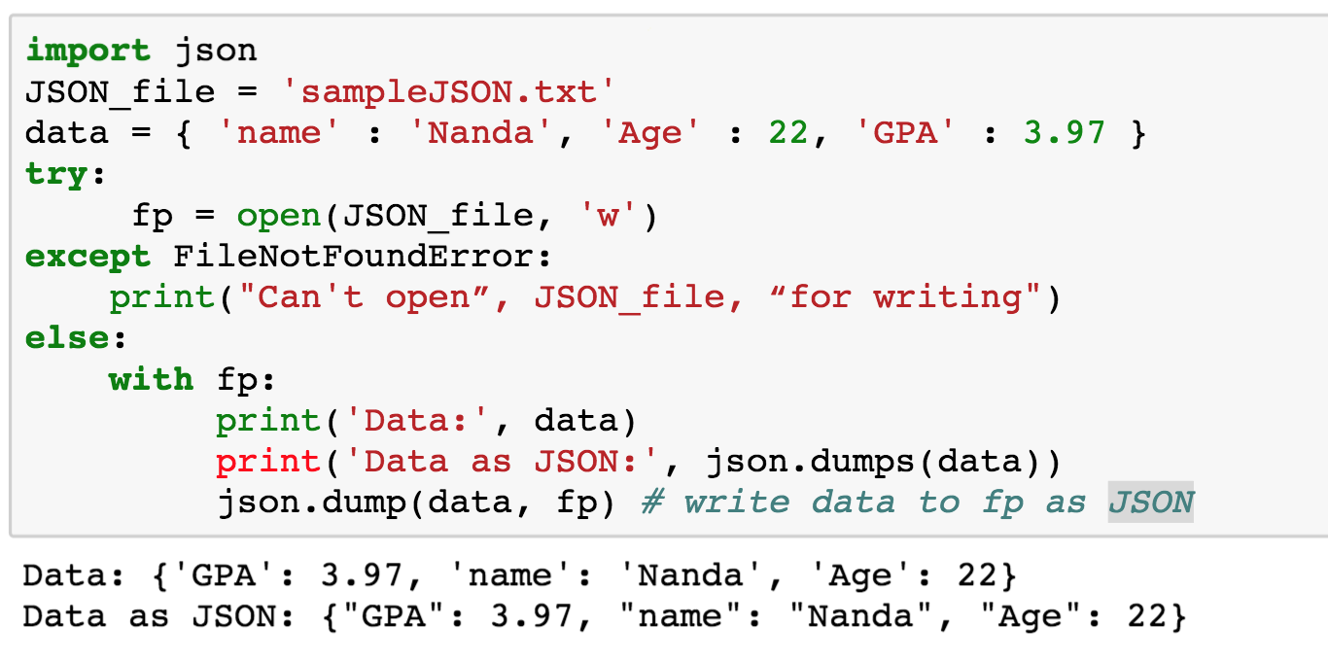
Writing JSON files
JSON is commonly used by web applications

Slide 50
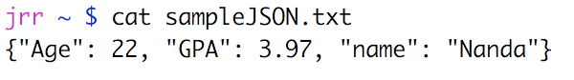
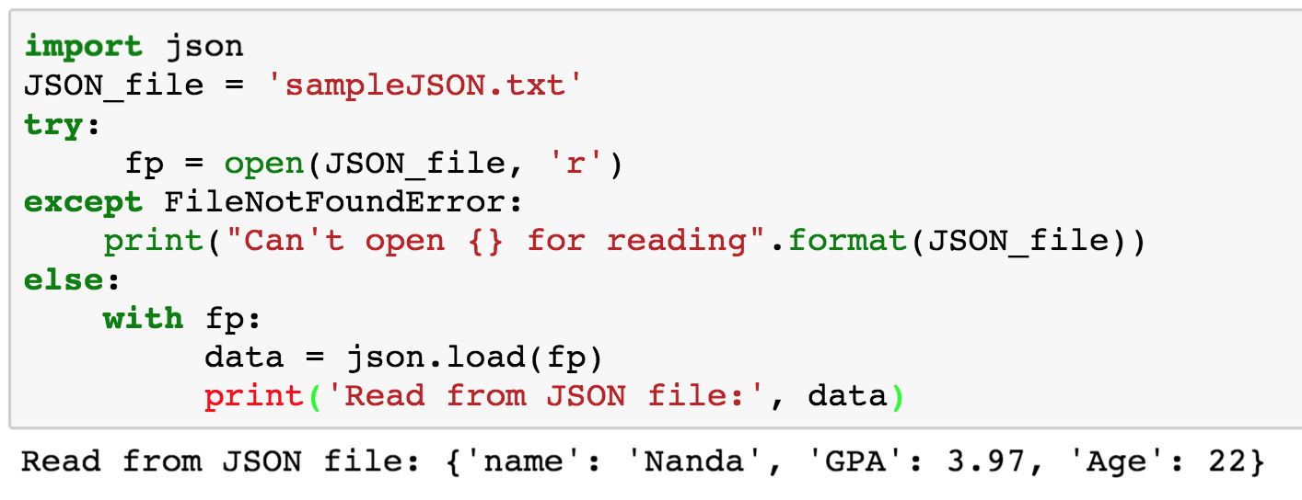
Reading JSON files

Slide 51
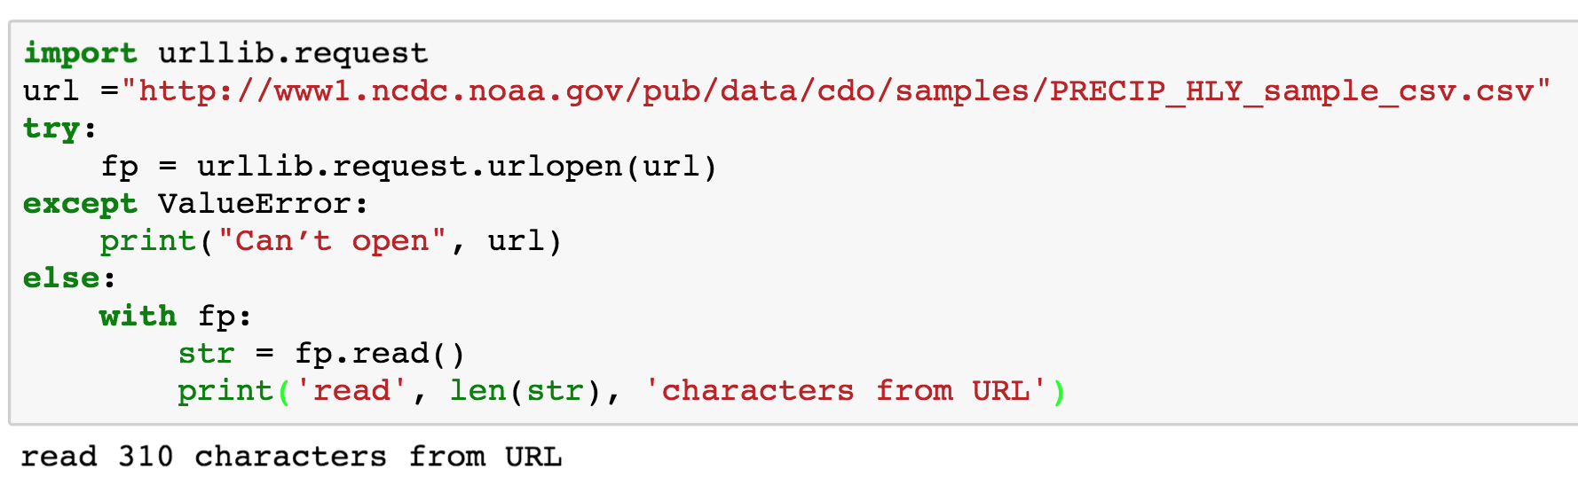
Reading from the Web
Python supports reading arbitrary URLs from the Web
Approach is analogous to reading from files

Slide 52

Reading from the Web
Several good solutions for reading from the web
Urllib – open arbitrary resources by URL
Requests – HTTP for Humans
BeautifulSoup4 – parses data from HTML and XML files
Scrapy – scraping and web crawling
Good solutions for parsing HTML, JSON, XML, etc.
Tweepy - reads from the Twitter feed

Slide 53
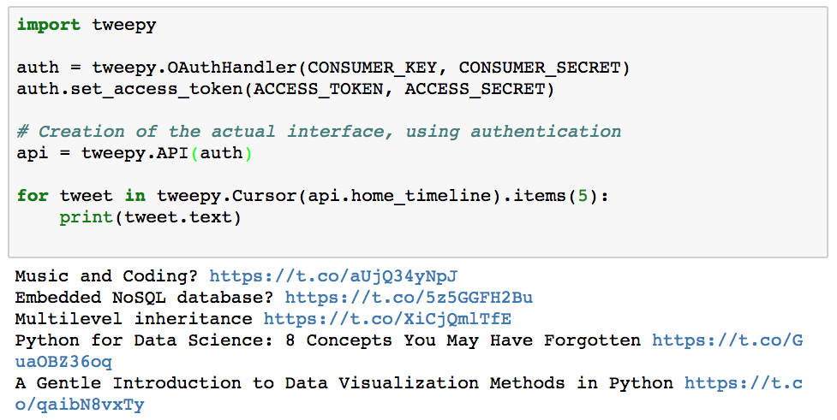
Accessing Twitter from Python with Tweepy

Slide 54

Questions?

